Slide 1
NOT AVERAGE SELLING APP
$
YOUR
Paul Raab, Serena Brown, GezuHegn Hika, Marilyn Wadsworth

Slide 2

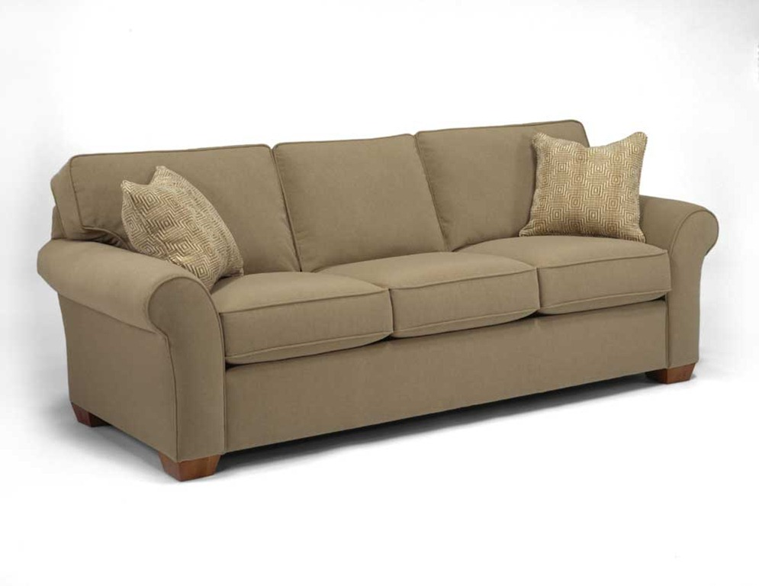
Why do you need this App?
Scenario:
I’m moving away, and I want to get rid of my couch fast!
2. Or vice-versa, on a budget looking for a great deal and I’m not picky.

Slide 3
Our Solution!
Buyer friendly
Seller friendly
Localized
Not as sketchy as Craiglist
Not a place to sell merchandise
Online yard sale!

Slide 4
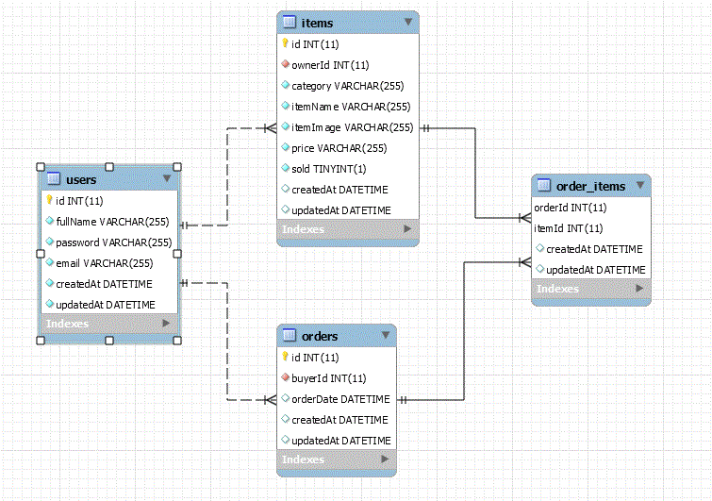
Schema- Data Flow

Slide 5
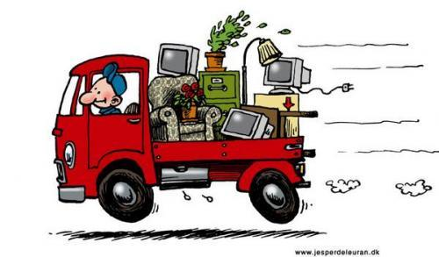
demo!- https://project-threee.herokuapp.com/

Slide 6
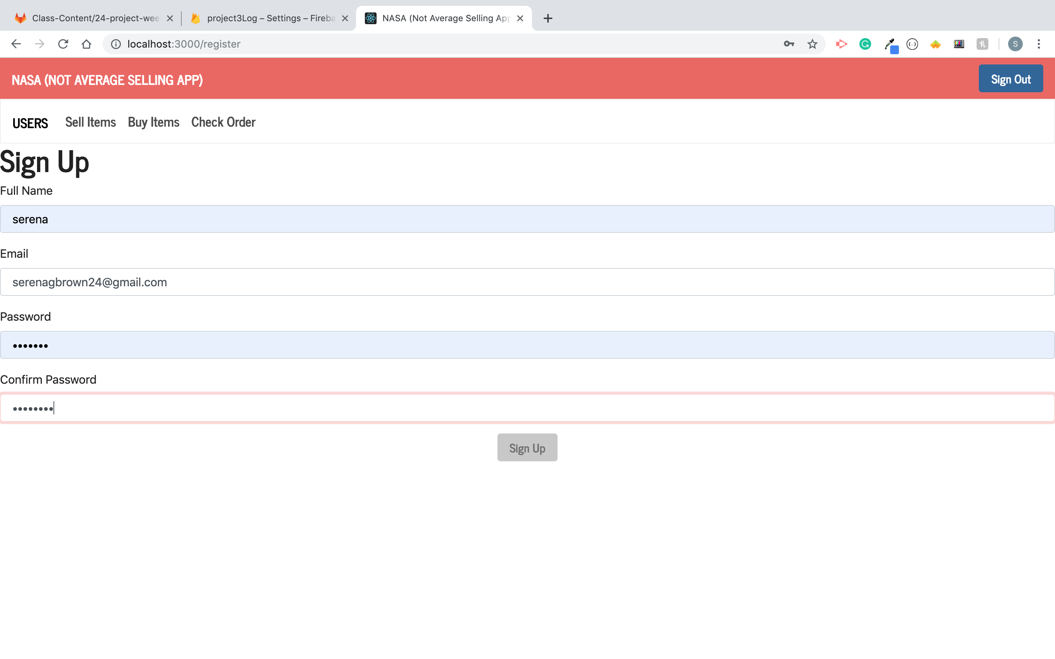
Sign Up

Slide 7
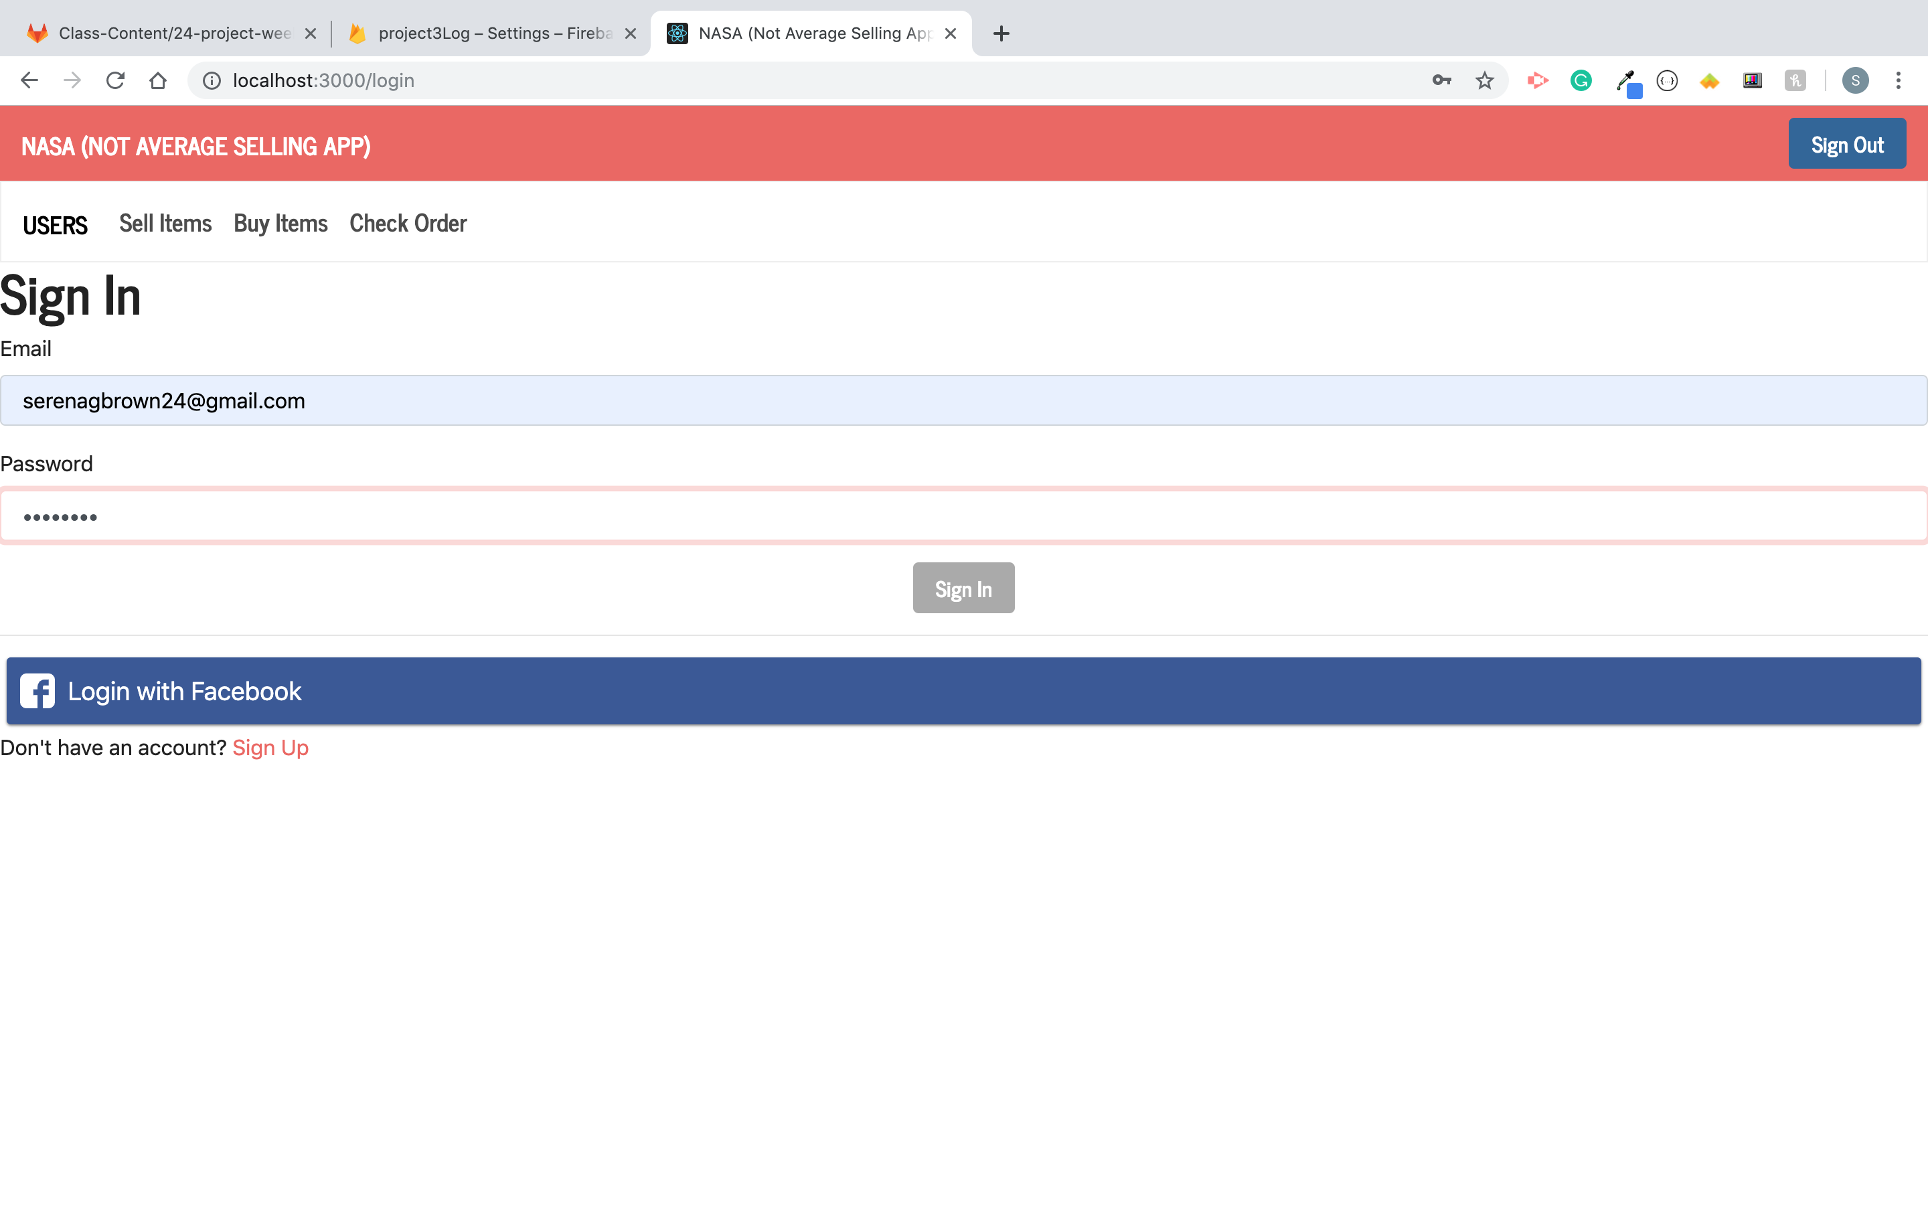
Login Page

Slide 8
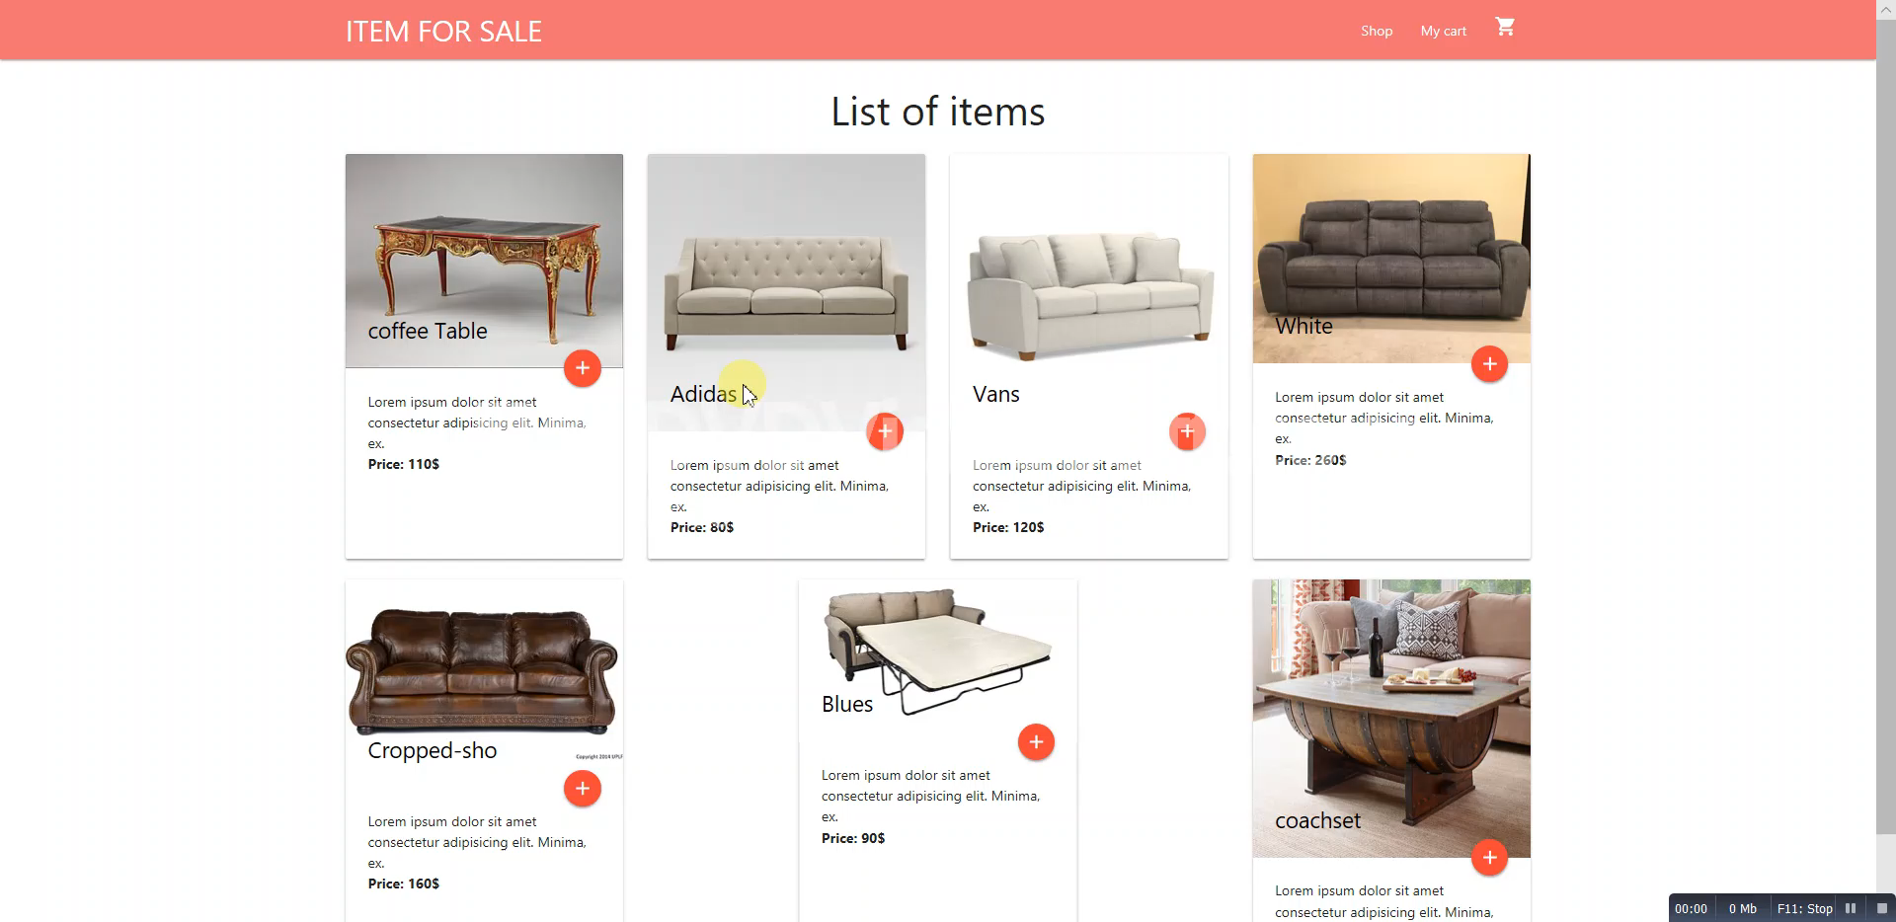
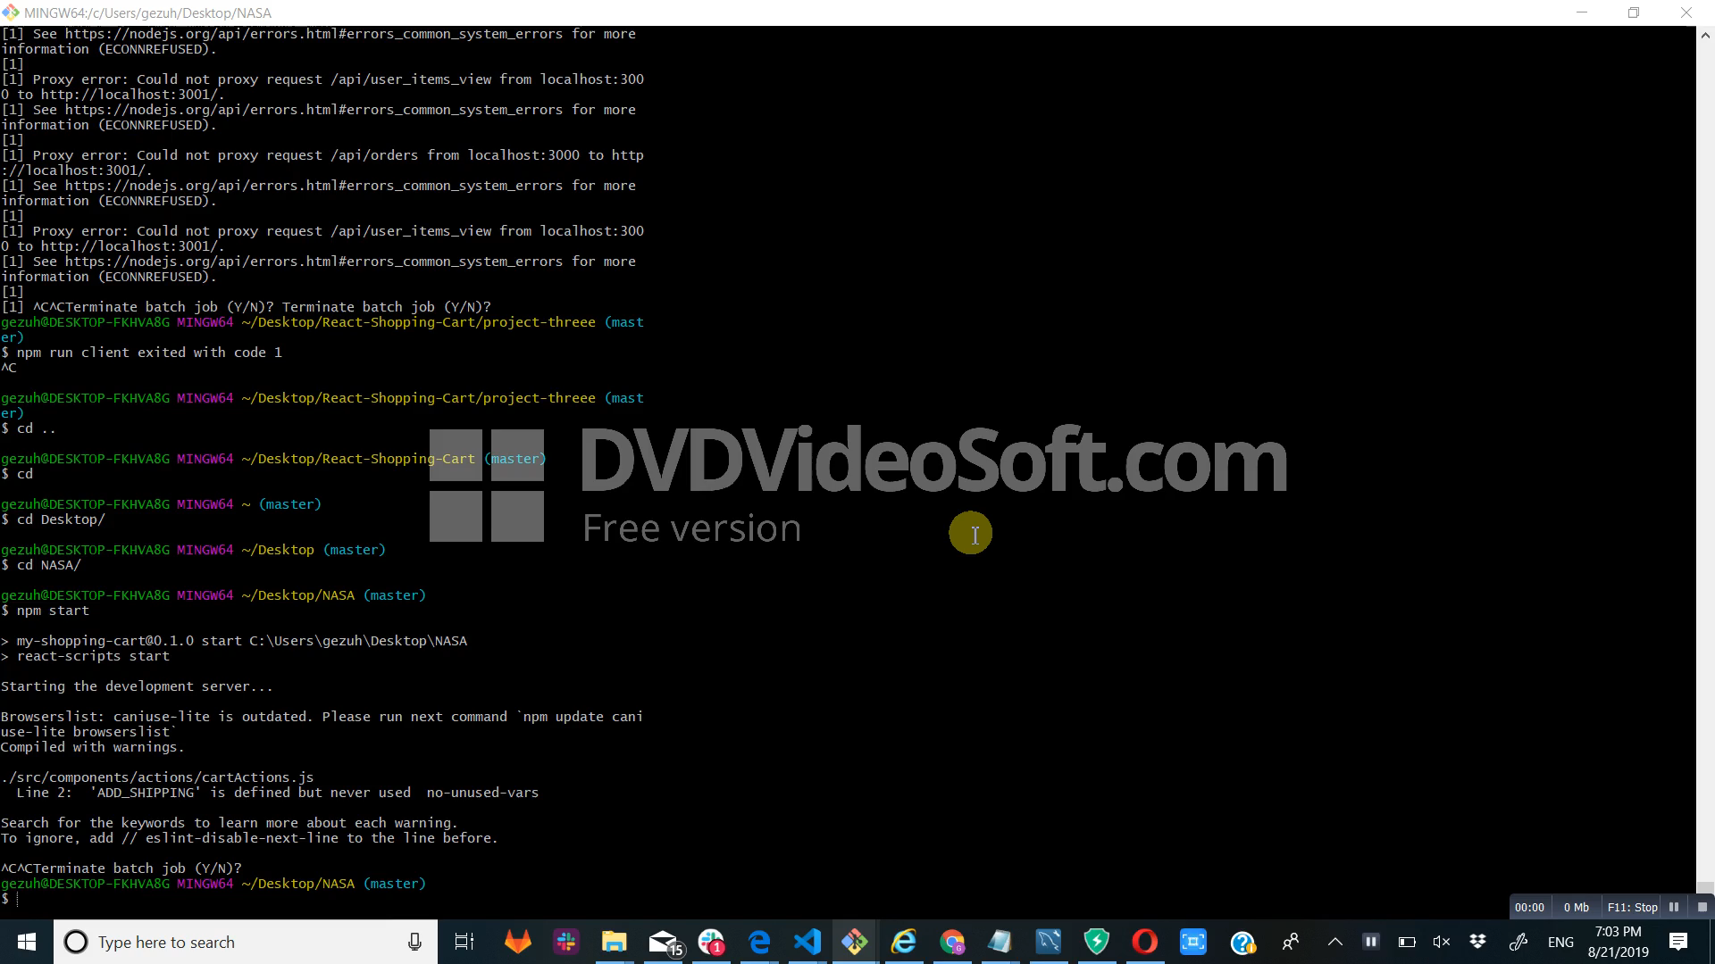
Nice to haves:

Slide 9
Struggles:
Communication
Mongo DB vs. Firebase vs. MySQL
React.js

